Slide 1
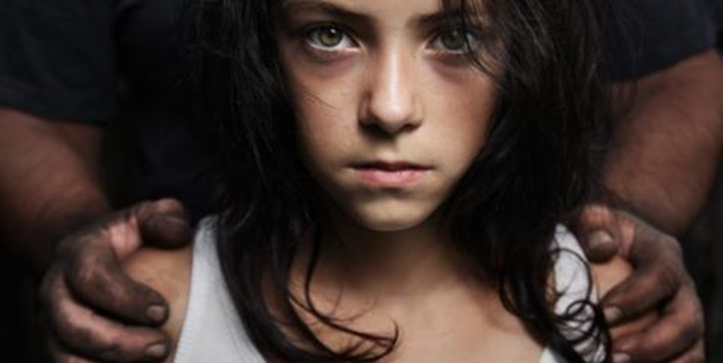
What is Human Trafficking?

Slide 2
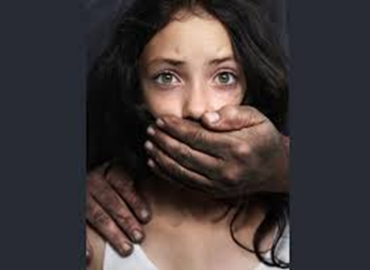
Human Trafficking/ Sex Trafficking
Any person who deprives or violates the personal liberty of another with the intent obtain forced labor or services, is guilty of human trafficking and shall be punished by imprisonment in the state prison for 5, 8, or 12 years and a fine of not more than five hundred thousand dollars ($500,000). ~PC236.2

Slide 3
Fifteen years to life and a fine of not more than five hundred thousand dollars ($500,000) when the offense involves force, fear, fraud, deceit, coercion, violence, duress, menace, or threat of unlawful injury to the victim or to another person~ PC236.2(c)

Slide 4
Punishment for Manslaughter
193(a) PC- Voluntary manslaughter is punishable by imprisonment in the state prison for 3, 6, or 11 years

Slide 5
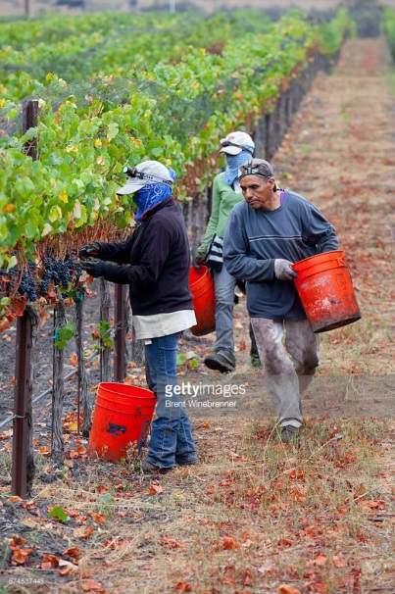
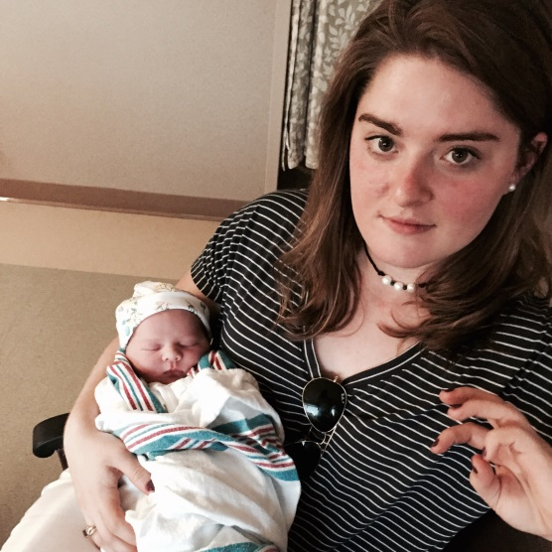
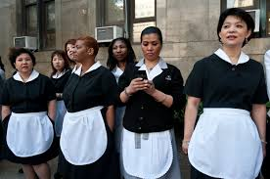
LABOR TRAFFICKING
  Associated Jobs
    Farm worker
    House Cleaner/ Maid
    Nanny

Slide 6
Signs of Labor Trafficking Victims
Avoid eye contact
Timid, don’t speak much or don’t understand English
Lack any sort of identification
Appear very tired all the time
Visible bruising

Slide 7
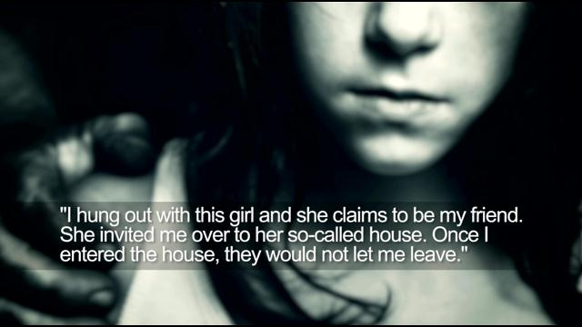
Sex Trafficking

Slide 8
Who are the victims?
There is no universal “type” of victim…
• Come from all demographic and socio‐economic
Categories (Disproportionately minorities)
• No single method of entry: child abductions,
brainwashing, drug addiction, poverty, etc.
•Except that most victims are vulnerable

Slide 9






Sex Trafficking Victims
• Most were recruited as minors, usually between 12‐16 years old

Slide 10

Sex Trafficking Victims
75‐95% sexually abused as children. 89% of prostituted persons are or were controlled by pimps when first entering the lifestyle.
In 2015, an estimated 1 out of 5 endangered runaways reported to the National Center for Missing and Exploited Children were likely child sex trafficking victims.
***FOSTER HOMES***

Slide 11
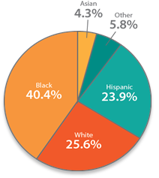
Victims by race
April 2015
U.S. Department of Health & Human Services
Administration for Children & Families

Slide 12
Comparing Demographics Of Victims To General Population

Slide 13
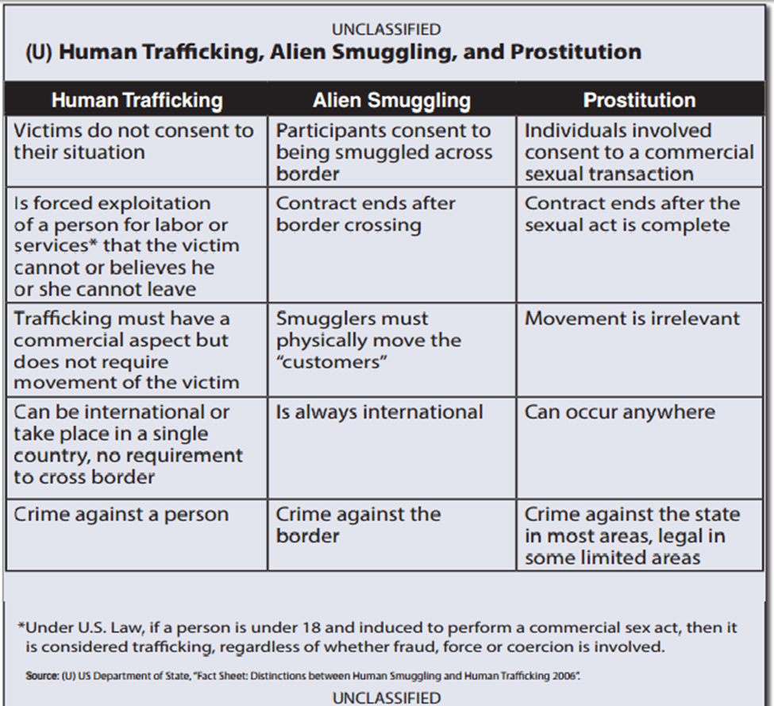

Slide 14


Slide 15

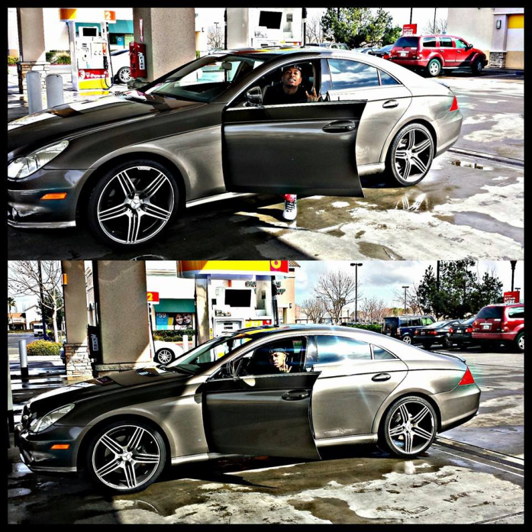

How they get into the lifestyle
Romeo Pimp

Slide 16
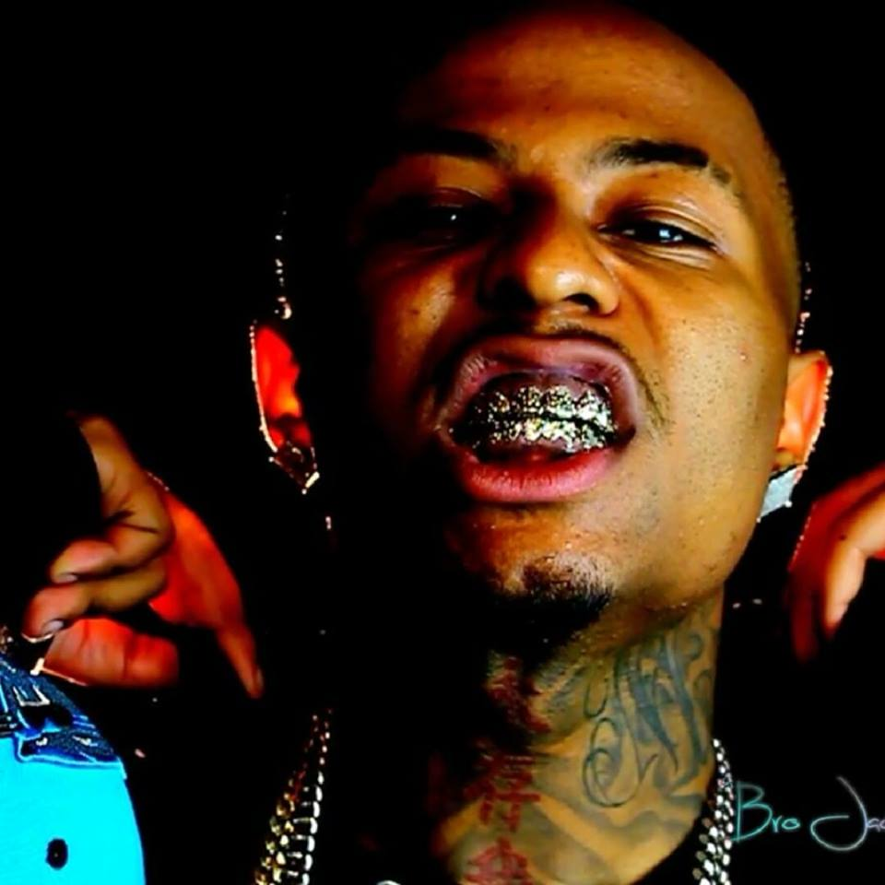
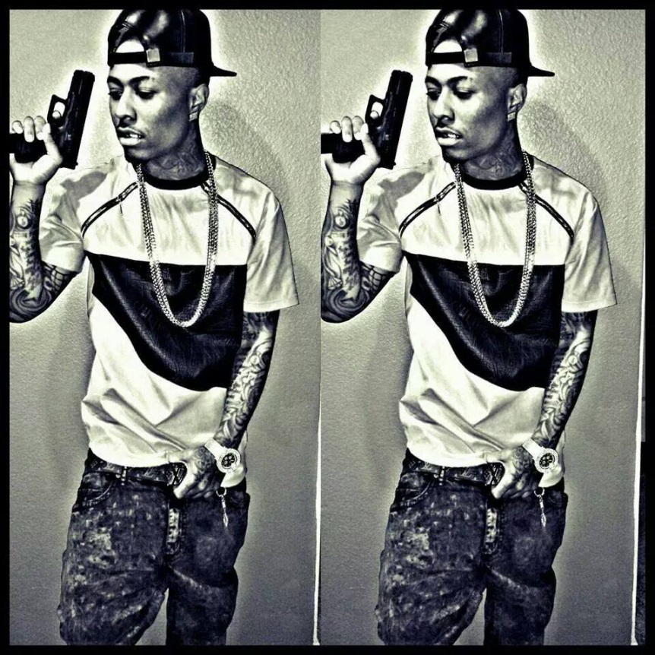
Gorilla Pimp

Slide 17




Why get in the lifestyle?
Feel acceptance
Feel wanted
Glamour
  $$$, Fancy Cars, Getting high Material things
Lack of Role Model/Family support
Peer Pressure (Foster Homes)
Society?? Music, TV

Slide 18
You know I - thug em, fuck em, love em, leave em
Cause I don't fuckin need em
Take em out the hood, keep em lookin good
But I don't fuckin feed em
First time they fuss I'm breezin
Talkin bout, "What's the reasons?"
I'm a pimp in every sense of the word, bitch
Better trust than believe em
In the cut where I keep em
til I need a nut, til I need to beat the guts
Then it's, beep beep and I'm pickin em up
Let em play with the dick in the truck
Many chicks wanna put Jigga fist in cuffs
Divorce him and split his bucks
Just because you got good head, I'ma break bread
so you can be livin it up? Shit I..
parts with nothin, y'all be frontin
Me give my heart to a woman?
Not for nothin, never happen
I'll be forever mackin
Heart cold as assassins, I got no passion
I got no patience
And I hate waitin..
Hoe get yo' ass in
And let's RI-I-I-I-I-IDE.. check em out now
RI-I-I-I-I-IDE, yeah
And let's RI-I-I-I-I-IDE.. check em out now
RI-I-I-I-I-IDE, yeah

Slide 19

MUSIC VIDEO

Slide 20


Slide 21
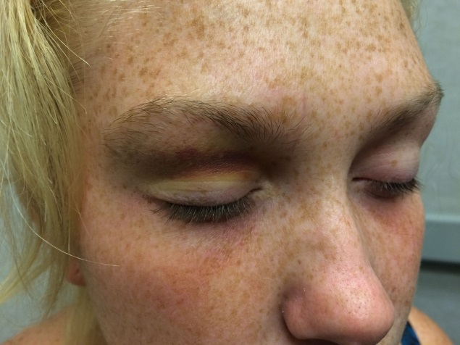
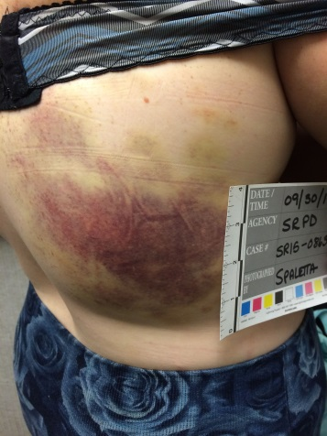
REALITY
https://www.youtube.com/watch?v=vp9nASeiyLM&feature=share

Slide 22
Sex Trafficking Terms
Daddy – Name For Pimp
Out of pocket – No Pimp (Bullied Into Getting a Pimp)
In pocket – Controlled By a Pimp
Folks – Other People Under Control of Pimp
Sister in law – Name for Girls Under Same Pimp
Bottom (Bitch) – Supervises Other Girls
Branding – Tattoo or Carving
Automatic – Routine Work (Pimp in Custody)
Stable – Group of Girls Belonging to a Pimp
Track/Blade – Area Known for Pimping Activity
Circuit – Areas Girls Work
Trick - Customer
John - Customer

Slide 23

Signs and Symptoms
Tattoos
  Crowns
  “Daddy’s girl”
Bruising
Demeanor
  Withdrawn
  Paranoid
  Uncooperative

Slide 24
Why don’t they just leave??
(Italicized statements are from actual survivors)
I WOULD ISOLATE HER, BREAKING HER TIES WITH ANY SUPPORT SHE HAD:
□ I took all of the money so that she depended on me for everything.
(Survivor: “At first, I felt I was a contributor to the home, but then I questioned why he had to control EVERYTHING. He insisted that he take me to the grocery store. He paid the power bills, he mocked me if I didn’t eat what he ate.”)
□ I would start a fight before she visited with friends and family so that eventually, she just stopped visiting.
(Survivor: “I felt too guilty about leaving after an argument. I was also too embarrassed for my family to see my bruises.”)

Slide 25
□ I had her back me up on illegal things so that I could hold it over her head if she tried to leave.
(Survivor: “He would tell me that he’d turn me in if I tried to leave.”)
□ I told her how fat and ugly she was all the time, and how badly she did things around the house. I told her how embarrassed I was of her.
(Survivor: “I’ wanted him to adore me so I tried really hard to do things to get his approval.”)

Slide 26
□ I told her that no one else would want my sloppy seconds, that she was used goods.
(Survivor: “No one else will understand. Who wants to marry a prostitute?”)
□ I told her that women’s shelters were for women who really needed it, not for women who wanted to give up on their family, not for whores and prostitutes.
(Survivor: “I believed him. I believed that the shelter staff would not take me in; thinking that it was my choice.”)
□ I ruined her credit by putting things in her name and not paying them.

Slide 27
JANE DOE #1
Birth to 12yrs old
Father Dies in work related accident
Mother is heavily addicted to drugs/Alcohol
Mother is very promiscuous and is with many different men
Possible sexual assault from one of the men
Moves in with Grandmother who does not speak any English

Slide 28
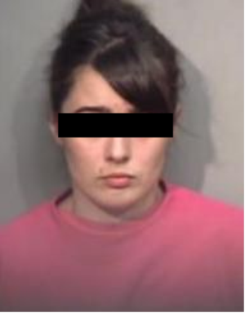

12yrs to 15yrs Old
Runs away numerous times
Gets kicked out of regular High School from lack of attending
Has little to no friends
Meets Michael Powell

Slide 29

At 15 years old (2009)
Gets manipulated (Romeo Pimped) into prostitution
Gets Beat up when she is out of pocket
Is forced to prostitute in the Canal Area of San Rafael
Becomes a part of an altercation between local Sureno Gang members
Is a witness to a murder

Slide 30
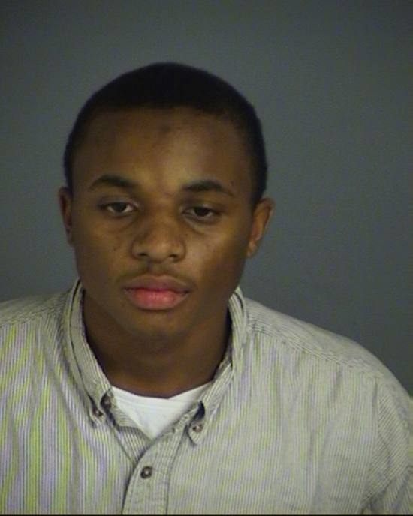
Michael Powell received 13 years prison term for “voluntary manslaughter” with a gun enhancement
Law Enforcement Mistakes
Should have treated Jane Doe more as a victim
Should have charged him with 236.2 (c) PC

Slide 31
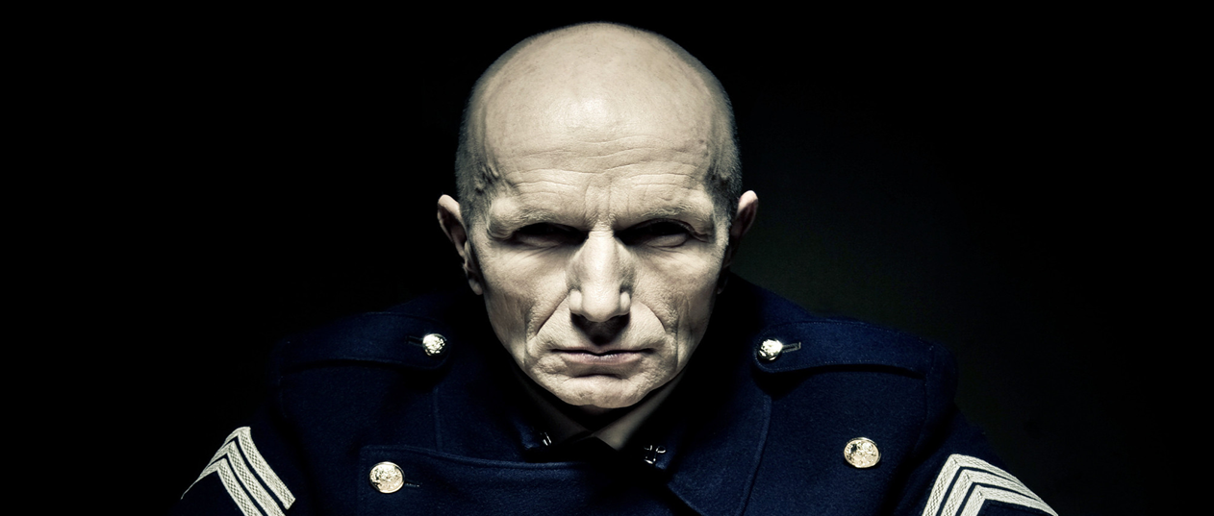
Law Enforcement View point
647(b) PC = Prostitution=Bad
In 2002 Law Enforcement Officers would conduct undercover stings targeting woman (children) working as prostitutes
Can be compared to DUI’s and Domestic Violence

Slide 32
What Law Enforcement is doing now?
Focusing on the fact that prostitutes may be victims
More thorough investigations
Education
Focusing on the demand/johns

Slide 33

Video: Tricked

Slide 34
The Demand Today
• Web sites where commercial sex is available
– 100+ websites
– 1000’s of ads
– Backpage.com: 25,000 ads per month for Jul, Aug, Sep
• In 2014 ASU concluded there were 6800 buyers soliciting sex on one site in 24 hours
• Detectives will get 150‐250 responses to prostitution ads in 8 hours

Slide 35
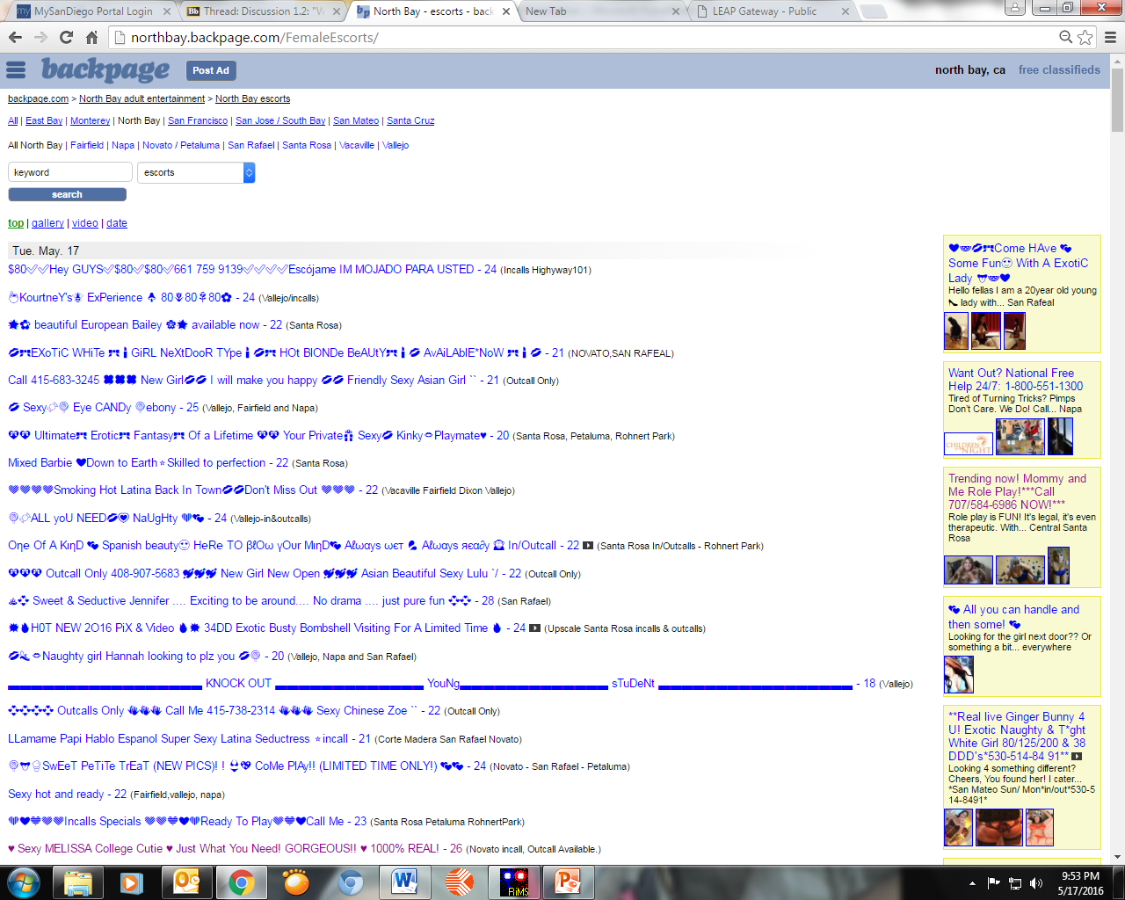

Slide 36
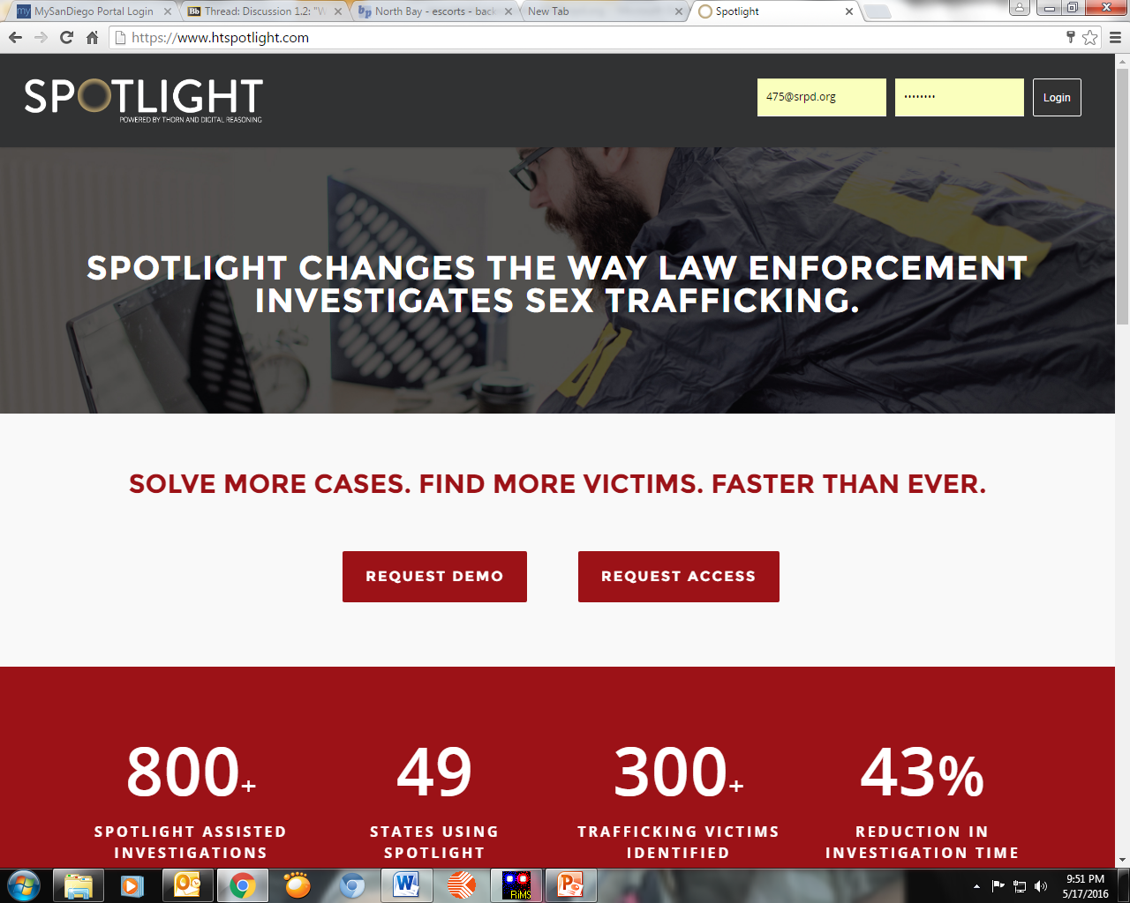

Slide 37
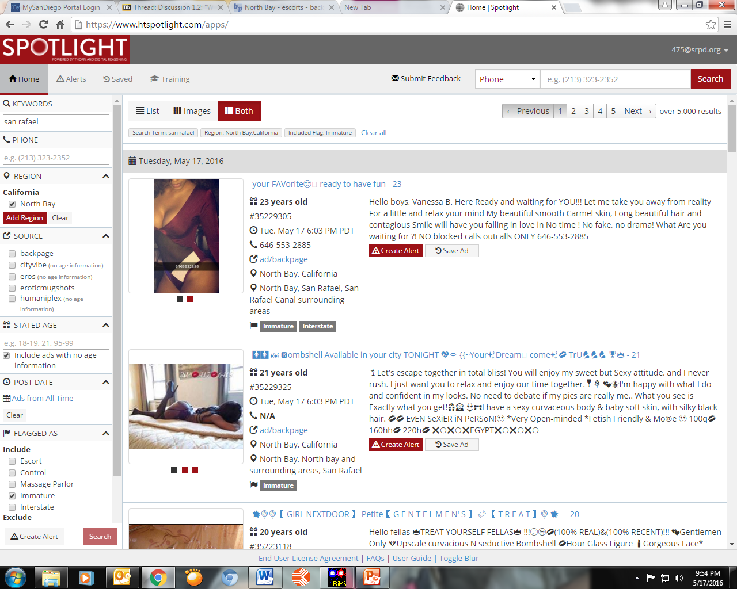

Slide 38


Slide 39
Resources
Community Violence Solutions- 800-670-7273
CPS (If a Minor) 415-499-7153
Polaris Project-(National HT hotline) 888-373-7888
  Or Text “Befree” 233733
“Supreme Nails” business card- Direct line to the Bay area (CVS) Human Trafficking service center
SHELTERS
  CVS and MAWS both have access to adult services
  CPS should handle if they are a minor

Slide 40
