Slide 1

Essential Duties & Responsibilities of San Rafael Police Department Records Division

Slide 2
Answers and evaluates all non-emergency calls for service. Inbound/outbound calls handled by Records/Dispatch August 2019 = 9,687 calls
Enters information into the CAD (Computer Aided Dispatch) system about calls for service including type, location, nature and description of the event.
Evaluates and handles all in-person requests for service at the front counter of the police station.
Provides callers and walk-in customers with assistance, information, or referral on situations that they determine not to be police-related but civil issues.

Slide 3
Processes and maintains a wide variety of police reports, documents, and records in both electronic and paper format; enters and retrieves information from other law enforcement data bases and resources. Average Reports a year 9,000-10,000 report.
Maintains and ensures the integrity and security of all confidential police records and reports.
Prepares mandated statistical and other reports for the State Department of Justice.
Prepares both standardized and specialized letters, records and reports; prepares releases for impounded and stored vehicles and criminal record clearances.

Slide 4
Citizen call to SRPD
Call creates Inc. #
Doesn’t constitute need for officer to respond
Officer responds
No report taken/call handled/10-22/GOA, ETC.
Officer takes report/writes and Supervisor approves (could take several days to complete)
Records review cases to ensure all info correct and supporting documents are present
Records kick back reports if documents are missing/wrong info
Records route cases to DA/AOA/CHP/DMV/State parole/Etc.
Records locks down cases in computer, so no one can edit

Slide 5
Incidents that we wouldn’t respond to
Homeless subjects on public property who aren’t doing anything criminal
In short, the court decided in Martin v. Boise that a jurisdiction could not cite/arrest homeless subjects for camping on public property when no other viable option was available (Sunrise-Sunset)
Persons sleeping in vehicles on city streets/city property
Private property accidents without injury
Officer can assist w/ the exchange of information
Private property parking issues other than red zone/handicap violations
Thefts/vandalism/identity theft/lost property/auto burglary with out suspect information

Slide 6
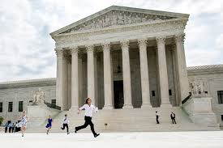
Court Run

Slide 7
Common forms we use:
Application for Release
Counter Report
Property(Lost/Stolen)
Vandalism/Graffiti
Theft
Identity Theft
Vehicle Burglary
(No Suspect Information)
Property Damage/Collision (CHP 555)
Vehicle Report (CHP 180)
Notes:
handout

Slide 8
California Public Records Act
Public Records Act is designed to give you public access to information in possession of public agencies. All state and local agencies are covered.
Gov’t Code 6250-6276.48
Some records exempt from disclosure are:
Police Incident reports, rap sheets and arrest records.

Slide 9

Reports never released without court ordered subpoena
Notes:
Elaborate on what we do/can release.
Report In question/ date and time of report/ date and time of occurrence/factual circumstances/general description/response/victim- the information is being withheld and not disclosed on the grounds of the privacy interests of the victim pursuant to Article 1, Section 1 of the California Constitution, Government code Section 6254 (k), and the balancing test under Government Code Section 6255
Injuries:

Slide 10

Mental/Welfare Checks

Slide 11


CPS Reports or Adult Protective Reports

Slide 12

Full Arrest Reports

Slide 13

Coroner’s Report

Slide 14

Press Log
Viewable from 30 Days of arrest, just brief summary of case and who was arrested.
After 30 days it becomes a matter of Criminal History which is not available for public release

Slide 15
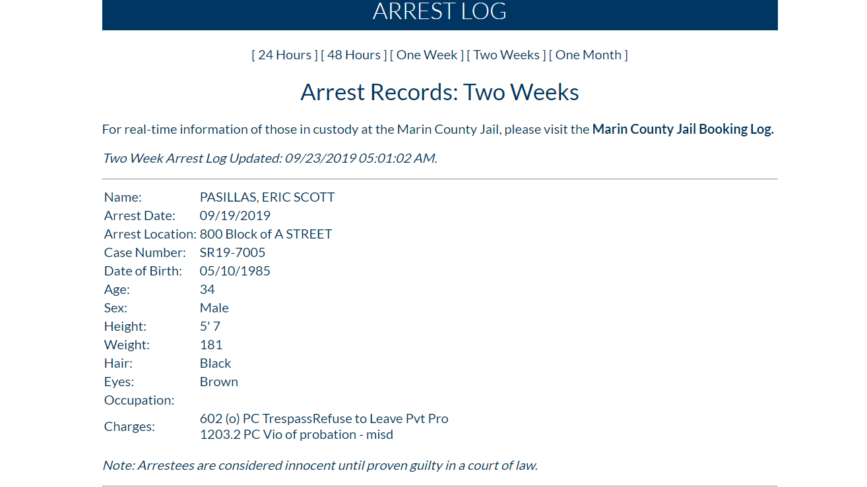

Slide 16
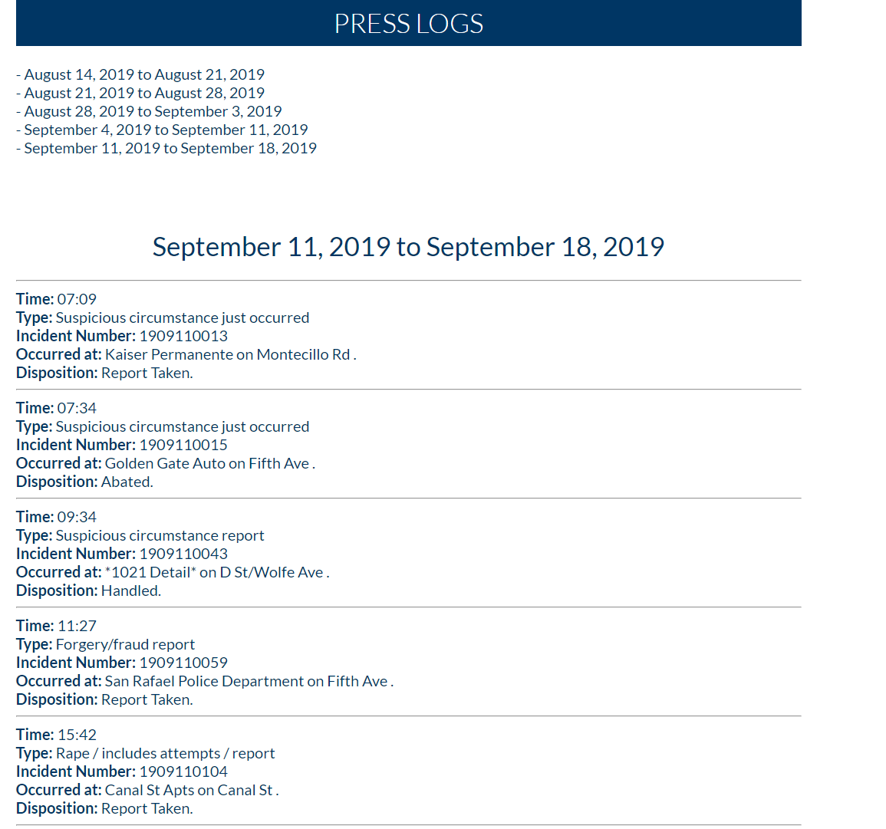

Slide 17
Other Services
Incident Reports
Accident Reports
Reports for Crime victims
Correctable Traffic Citation signoffs
(tinted windows, no plates, brake lights/taillights out, expired registration tabs)

Slide 18
Other Services Cont.
Clearance Letters (Fee $27.00) for Immigration, travel or adoptions
Repo Receipts (Fee $15.00)
Vehicle Release (Admin Fee $327.00) if vehicle was impounded for 30 days. Fee is for the time the officer has to wait for tow, processing paperwork

Slide 19
How you can help…
YOU CAN REPORT CERTAIN INFORMATION ON
https://www.cityofsanrafael.org/#/city/report

Slide 20
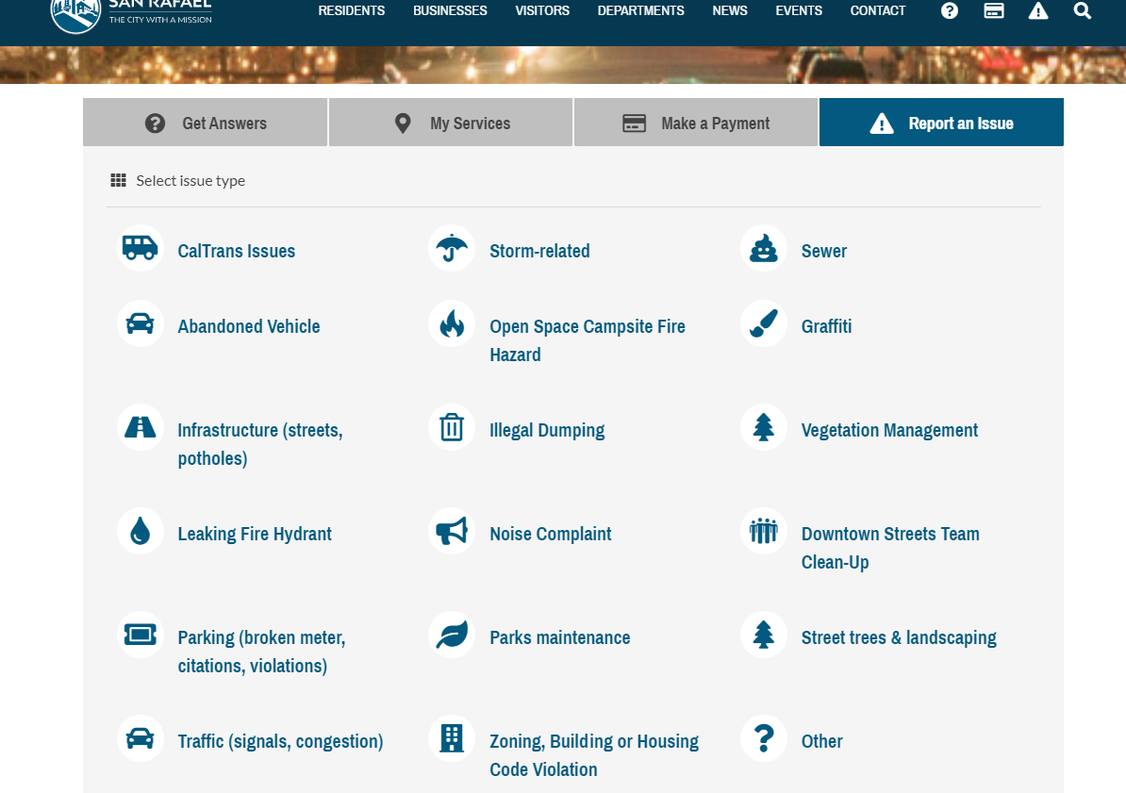
How you can help

Slide 21

Thank you for your time
Please feel free to contact me with any questions at 415-485-3000 or 610@srpd.org

Slide 22
Business Hours
Lobby opened from 8:00am -5:00pm
Monday- Friday
10:00am-2:00pm
Saturday
Closed Sunday & Holidays

