Slide 1
ACTIVE SHOOTER PREPAREDNESS
For Government Offices, Schools, Hospitals and Other Facilities

Slide 2
PROFILE OF AN ACTIVE SHOOTER
An active shooter is an individual actively engaged in killing or attempting to kill people in a confined and populated area, typically through the use of firearms.
Fort Hood, Texas (2009)
13 dead, 32 injured
Route 91 Music Festival
Las Vegas, NV (2017)
58 killed, 546 injured
Helen Vine Detox
San Rafael, CA (2018)
1 killed, 2 injured
Columbine High School
Jefferson County, Colorado (1999)
15 dead, 24 injured
Luby’s Massacre
Killeen, Texas (1991)
22 dead, 20 injured
San Bernardino, Calif. (2015)
14 dead, 21 injured
Rancho Tehema, CA (2017)
5 killed, 10 injured
Nightclub
Orlando, Florida (2016)
50 killed, 53 injured
Sandy Hook Elementary
Newtown, Connecticut (2012)
27 dead, 1 injured
Municipal Center
Virginia Beach, VA (2019)
13 killed, 4 injured
939 East Blithedale
Mill Valley, CA (2018)
1 killed, 1 injured
Multiplex Movie Theater
Aurora, Colorado (2012)
12 dead, 58 injured
Virginia Tech University
Blacksburg, Virginia (2007)
32 killed, 17 injured

Slide 3
HOW TO RESPOND WHEN AN ACTIVE SHOOTER IS IN YOUR VICINITY
Quickly determine the most reasonable way to protect your own life. Customers and clients are likely to follow the lead of employees and managers during an active shooter or other emergency situation.
RUN – HIDE– FIGHT
CALL 9-1-1 WHEN IT IS SAFE TO DO SO
(Dial 9-911 from a business centrex phone)

Slide 4
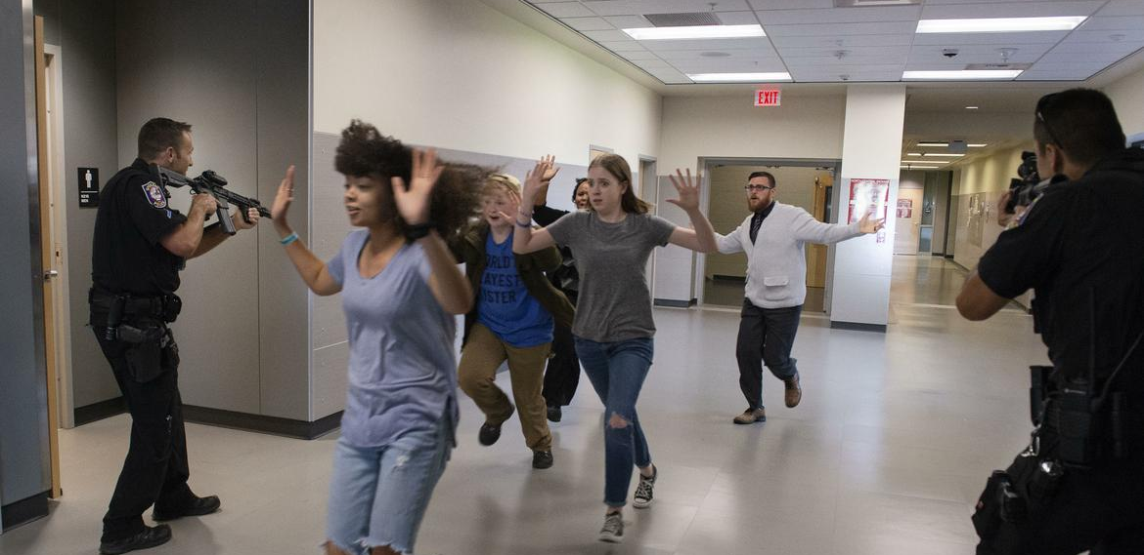
1. RUN
Have an escape route and plan in mind (be familiar with your workplace and surroundings – exits, alternatives)
Leave your belongings behind
Keep your hands visible

Slide 5
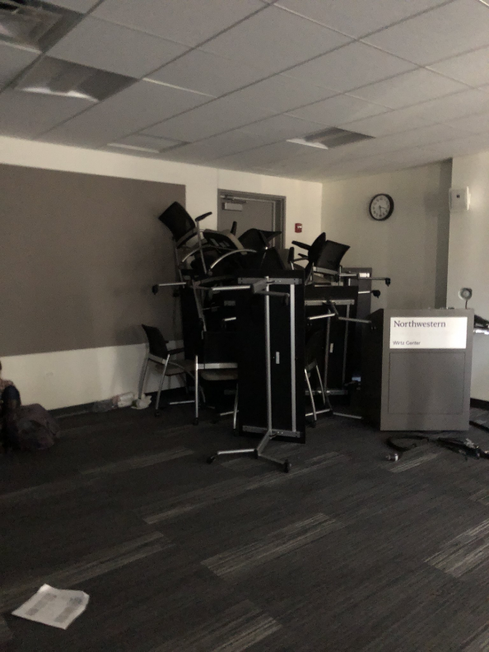
2. HIDE / LOCKDOWN
Hide in an area out of the active shooter’s view
Block entry to your hiding place and block the doors
CALL 911 WHEN IT IS SAFE TO DO SO
(9-911 from a business centrex phone)

Slide 6
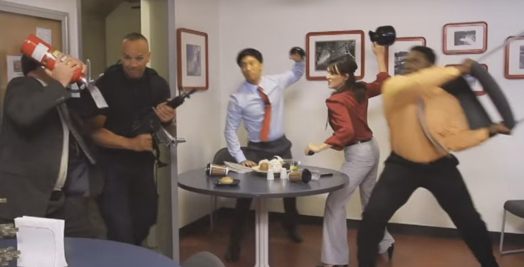
3. TAKE ACTION
As a last resort and only when your life is in imminent danger
Attempt to incapacitate the active shooter
Act with physical aggression and throw items at the active shooter

Slide 7
HOW TO RESPOND WHEN PROVIDING INFORMATION TO A 9-1-1 CALL TAKER / DISPATCHER AND WHEN LAW ENFORCEMENT ARRIVES ON THE SCENE
Suggested reactions to law enforcement arrival:
Try to remain calm, and follow officers’ / deputies’ instructions
Immediately raise hands and spread fingers
Keep hands visible at all times
Avoid making quick movements toward officers such as attempting to hold on to them for safety

Slide 8
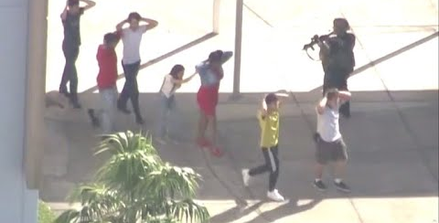
HOW TO RESPOND WHEN PROVIDING INFORMATION TO A 9-1-1 CALL TAKER / DISPATCHER AND WHEN LAW ENFORCEMENT ARRIVES ON THE SCENE
Be prepared to react when law enforcement arrives:
Avoid pointing, screaming and / or yelling
Do not stop to ask the officers for help or direction when evacuating, just proceed in the direction from which officers are entering the premises
Law enforcement investigators may gather you in a safe area to conduct an interview

Slide 9
Reporting to Law Enforcement
Information to provide to law enforcement or 911 operator (WHO, WHAT, WHERE, WHEN, WHY, HOW):
Location of the active shooter
Number of shooters, if more than one
Physical description of shooter(s)
Number and type of weapon held by shooter(s)
Number of potential victims at the location

Slide 10
RECOGNIZING SIGNS OF POTENTIAL WORKPLACE VIOLENCE
An active shooter may be a current or former employee.
Alert your manager / supervisor or Human Resources Department if your believe an employee exhibits potentially violent behavior.
Notify management if you have a Personal Protection Order (PPO) against a person that may be a threat to you at work.
Review and follow your workplace violence policy and emergency action plans.

Slide 11
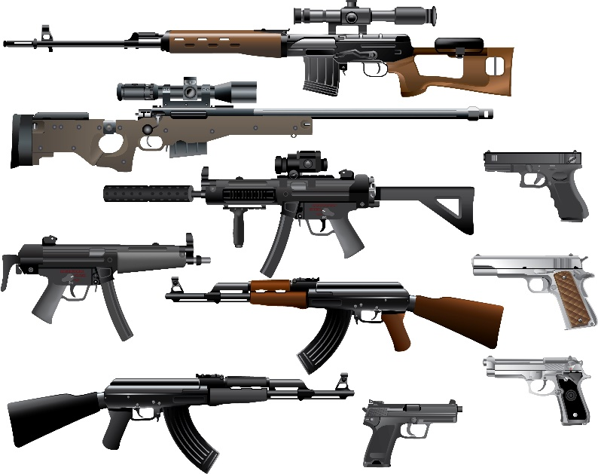
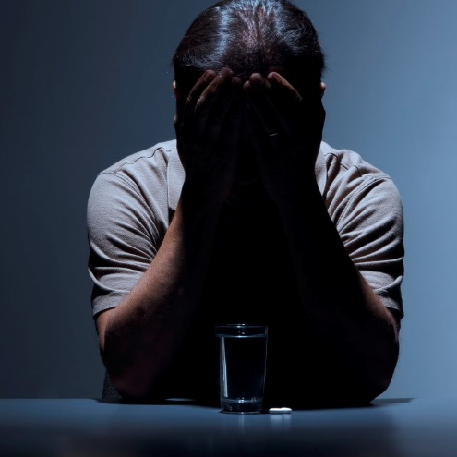
Indicators of potentially violent behavior may include one or more of the following:
Increased use of alcohol and/or illegal drugs
Unexplained increase in absenteeism, and/or vague physical complaints
Depression / Withdrawal
Increased severe mood swings, and noticeably unstable or emotional responses
Increasingly talks of problems at home
Increase in unsolicited comments about violence, firearms, and other dangerous weapons and violent crimes

Slide 12
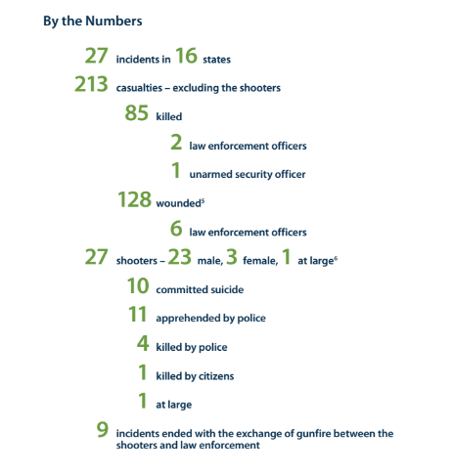
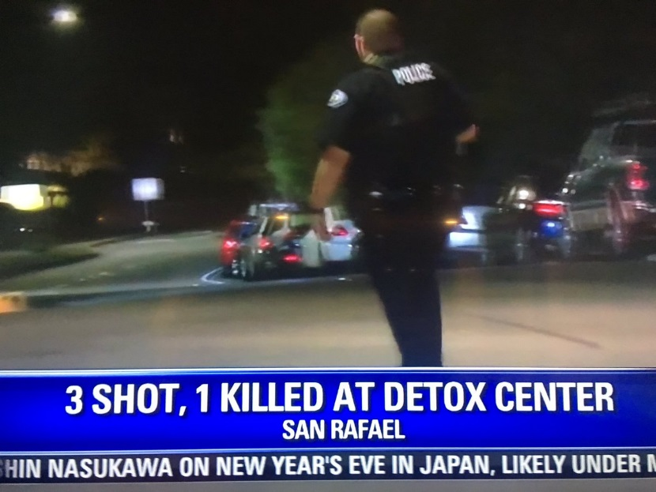
Active Shooter Statistics – 2018
Source: F.B.I.

Slide 13
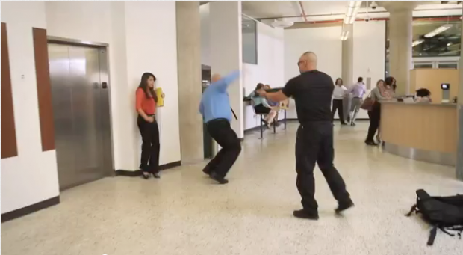
VIDEO
Houston Police video…
RUN, HIDE, FIGHT
Surviving an Active Shooter

Slide 14
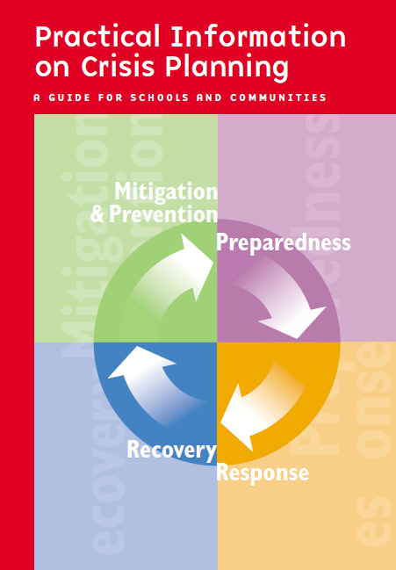
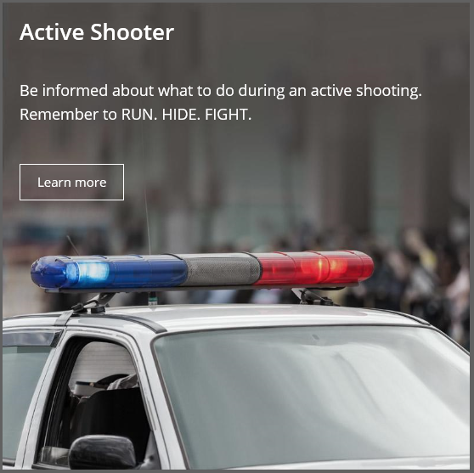
RESOURCES:
www.ready.gov

Slide 15
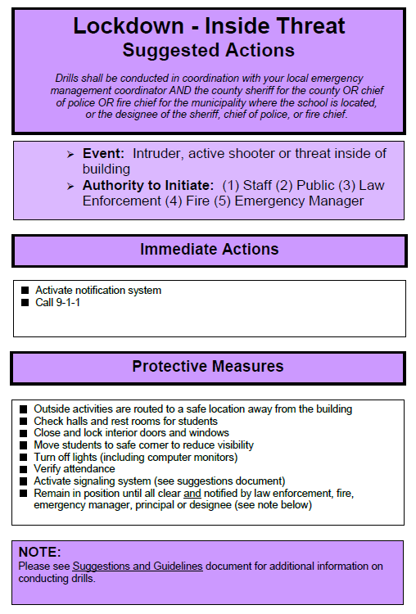
School Lockdown Drill
Suggested Actions

Slide 16
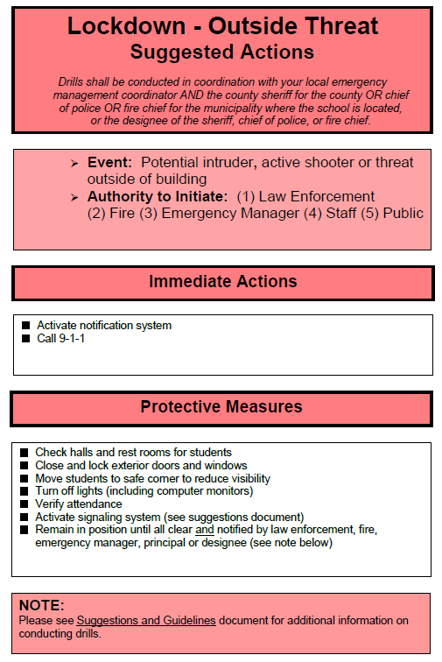
School Lockdown Drill
Suggested Actions

Slide 17
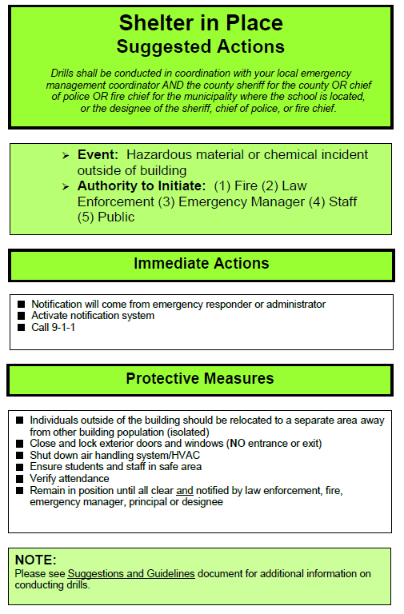
School Shelter-In-Place Drill
Suggested Actions

Slide 18
Questions?
Be Prepared ▪ Be Vigilant ▪ Be Resilient
THANK YOU!
SHERIFF or POLICE
Emergency
9-1-1 www.srpd.org

